Slide 1
Generalised and mixed GAM models
Claudia von Brömssen
Dept of Energy and Technology

Slide 2
Mixed models- dependent observations
Statistical models always require independent observations.
If observations are not independent usually
p-values are too low
confidence intervals are too narrow
In many studies were GAM models are interesting to use we have a time or space component, which also naturally leads to temporal or spatial autocorrelation between observations.

Slide 3
Mixed models- dependent observations
The presence of temporal or spatial correlations in when estimating smooth functions can also lead to
too complex functions = too little smoothing
If correlations between observations can be estimated they can also be incorporated in the model => models are called mixed models.

Slide 4
Correlation in time
To analyze if there is autocorrelation in a time series we can use the autocorrelation function.
acf(river$logTot.P, na.action=na.exclude)
Autocorrelations for the total phosphorus transport series.
There is high autocorrelation, especially a clear seasonal structure.

Slide 5
Correlation in time
Autocorrelations in time series can have several causes, e.g. :
Seasonal variation
Effects of autocorrelated explanatory variables
Trend
If the model we define accounts for some of these sources the remaining autocorrelations in the residuals of the model is typically much smaller than in the raw data.

Slide 6
Correlation in time
Autocorrelation in original series Autocorrelation when seasonal variation is removed

Slide 7
Correlation in time
Without seasonal variation without seasonal variation, influence of flow and trend

Slide 8
Correlation in time
model4g <- gamm(logTot.P~s(datenr)+s(Month, bs='cc') + s(logRunoff), data=river, correlation = corAR1())
summary(model4g$lme)
Correlation Structure: AR(1)
Formula: ~1 | g/g.0/g.1
Parameter estimate(s):
Phi
0.2774044
Fixed effects: y ~ X - 1
Value Std.Error DF t-value p-value
X(Intercept) 5.575500 0.01947148 357 286.34182 0
Xs(datenr)Fx1 -0.154891 0.01946324 357 -7.95812 0
Xs(logRunoff)Fx1 1.271152 0.12136436 357 10.47385 0

Slide 9
Correlation in time
From lme for model with correlations estimated
Fixed effects: y ~ X - 1
Value Std.Error DF t-value p-value
X(Intercept) 5.575500 0.01947148 357 286.34182 0
Xs(datenr)Fx1 -0.154891 0.01946324 357 -7.95812 0
Xs(logRunoff)Fx1 1.271152 0.12136436 357 10.47385 0
From lme for model with no correlations estimated
Fixed effects: y ~ X - 1
Value Std.Error DF t-value p-value
X(Intercept) 5.575513 0.01463065 357 381.0845 0
Xs(datenr)Fx1 -0.154499 0.01467732 357 -10.5264 0
Xs(logRunoff)Fx1 1.320282 0.13299947 357 9.9270 0

Slide 10
Correlation in time
It is generally difficult to separate high temporal autocorrelation and time trends.
Ignoring autocorrelation can result in exaggerated magnitudes or too low p-values for trend estimates.
In some application we have, however, also observed over-smoothing when autocorrelation is estimated simultaneously.

Slide 11
Correlation in time
How do we know that the model we used for autocorrelations is sufficient.
Here we were using a AR(1) model indicating that observations one time step are correlated.
What if the correlations structure is more complex?
We can check the residuals to see:

Slide 12
Residuals of mixed models in R
model4g <- gamm(logTot.P~s(datenr)+s(Month, bs='cc')+s(logRunoff) , data=river, correlation=corAR1())
acf(residuals(model4g$gam))
not modelling autocorrelation modelling autocorrelations
What is the difference?

Slide 13
Residuals of mixed models in R
The residual function for gam in R returns the residuals without adjustment or the correlation structure.
We can use instead:
acf(residuals(model4g$lme, type="normalized"))

Slide 14
Correlation in data
More about other types of dependencies in data later.

Slide 15
Generalized additive models
Just as for GLM the response variable in GAM can have other distributions than normal:
Binomial for 0/1 data, proportions
Poisson for count data

Slide 16
Generalized additive models
In GLM
for a binomial model the expected value after logit- transformation is modelled to be linearly dependent on the explanatory variables
for a Poisson model the expected value after log transformation is modelled to be linearly dependent on the explanatory variables
Again using GAM we can remove the assumption of linearity and allow a free form for the relationship.

Slide 17
Generalized additive models
As before, we have the choice between several functions/ packages in R.
gam
gamm
gamm4
Estimations in generalized models are more complicated than when assuming normality for the response and therefore different functions can give different results.

Slide 18
Generalized additive models
General recommendations for the choice of function:
No random terms or correlations: gam
Random terms or correlations and normally distributed errors or Poisson data: gamm
Random terms or correlations and binomial data: gamm4

Slide 19
GAM model for Count data
Data from the ’Svensk fågeltaxering’
Robins are counted each year on fixed routes. Here we use 2009 data in Southern Sweden.
Spatial expansion:
Larger dots if more robins are observed,
smaller ones for few

Slide 20
GAM model for Count data
The count of Robins during breeding season can be explained by e.g.
- temperature during spring time
- location
- kind of habitat, proportion of arable land, forest…
- other types of geographical structures

Slide 21
GAM model for Count data
A Poisson model for counts of Robin using temperature in April (temp4), proportion of coniferous forests (CF) and a spatial component (coordinates o1 and n1), lind is the count of robins:
modelC<-gam(lind ~ te(o1,n1) + s(temp4) + s(CF), family="poisson", data=bird_sub )
Thin plate splines for temperature and proportion of forest. Tensor products for the spatial component to allow differnt smoothing parameters in the north-south and the east-west component.
Poisson distribution is used.

Slide 22
GAM model for Count data
Family: poisson
Link function: log
Formula:
lind ~ te(o1, n1) + s(temp4) + s(CF)
Parametric coefficients:
Estimate Std. Error z value Pr(>|z|)
(Intercept) 2.32783 0.02576 90.37 <2e-16 ***
---
Signif. codes: 0 ‘***’ 0.001 ‘**’ 0.01 ‘*’ 0.05 ‘.’ 0.1 ‘ ’ 1
Approximate significance of smooth terms:
edf Ref.df Chi.sq p-value
te(o1,n1) 22.444 22.911 147.49 < 2e-16 ***
s(temp4) 8.796 8.984 60.29 7.59e-10 ***
s(CF) 6.259 7.407 106.01 < 2e-16 ***
---
Signif. codes: 0 ‘***’ 0.001 ‘**’ 0.01 ‘*’ 0.05 ‘.’ 0.1 ‘ ’ 1
R-sq.(adj) = 0.29 Deviance explained = 46.3%
UBRE = 2.5024 Scale est. = 1 n = 171

Slide 23
GAM model for Count data
High curvature in all smooth. What have we missed?

Slide 24
GAM model for Count data
Family: poisson
Link function: log
Formula:
lind ~ te(o1, n1) + s(temp4) + s(CF)
Parametric coefficients:
Estimate Std. Error z value Pr(>|z|)
(Intercept) 2.32783 0.02576 90.37 <2e-16 ***
---
Signif. codes: 0 ‘***’ 0.001 ‘**’ 0.01 ‘*’ 0.05 ‘.’ 0.1 ‘ ’ 1
Approximate significance of smooth terms:
edf Ref.df Chi.sq p-value
te(o1,n1) 22.444 22.911 147.49 < 2e-16 ***
s(temp4) 8.796 8.984 60.29 7.59e-10 ***
s(CF) 6.259 7.407 106.01 < 2e-16 ***
---
Signif. codes: 0 ‘***’ 0.001 ‘**’ 0.01 ‘*’ 0.05 ‘.’ 0.1 ‘ ’ 1
R-sq.(adj) = 0.29 Deviance explained = 46.3%
UBRE = 2.5024 Scale est. = 1 n = 171

Slide 25
GAM model for Count data
In Poisson models the basic assumption is that data is Poisson distributed, i.e. the mean is the same as the variance.
We can see that in the output as the scale estimate is set to 1, no specific variance is estimated.
However, in many practical applications this assumption does not hold: The data is overdispersed = we have more variation than what the Poisson model allows.

Slide 26
GAM model for Count data
Overdispersion is often quantified by computing the residual deviance divided by the residual degrees of freedom.
For gam there is no easy way to see how high this value is and therefore we check how the fit changes if we use quasipoisson instead, i.e. we allow the estimation of a separate variance.
modelCa<-gam(lind ~ te(o1,n1) + s(temp4) + s(CF), family="quasipoisson", data=bird_sub )

Slide 27
GAM model for Count data
Family: quasipoisson
Link function: log
Formula:
lind ~ te(o1, n1) + s(temp4) + s(CF)
Parametric coefficients:
Estimate Std. Error t value Pr(>|t|)
(Intercept) 2.37411 0.04997 47.51 <2e-16 ***
---
Signif. codes: 0 ‘***’ 0.001 ‘**’ 0.01 ‘*’ 0.05 ‘.’ 0.1 ‘ ’ 1
Approximate significance of smooth terms:
edf Ref.df F p-value
te(o1,n1) 10.059 12.636 1.654 0.0710 .
s(temp4) 1.000 1.000 3.660 0.0575 .
s(CF) 2.286 2.835 7.903 8.87e-05 ***
---
Signif. codes: 0 ‘***’ 0.001 ‘**’ 0.01 ‘*’ 0.05 ‘.’ 0.1 ‘ ’ 1
R-sq.(adj) = 0.248 Deviance explained = 34.2%
GCV = 4.4589 Scale est. = 4.2207 n = 171

Slide 28
GAM model for Count data
The scale estimate is larger than 1 and the resulting smooth are less wiggly after adjustment for overdispersion.
not accounting for overdispersion accounting for overdispersion

Slide 29
GAM model for Count data
If we use the gamm function instead a scale parameter is automatically estimated:
Approximate significance of smooth terms:
edf Ref.df F p-value
te(o1,n1) 3.001 3.001 2.018 0.113
s(temp4) 1.000 1.000 0.952 0.331
s(CF) 1.608 1.608 20.931 4.55e-06 ***
---
Signif. codes: 0 ‘***’ 0.001 ‘**’ 0.01 ‘*’ 0.05 ‘.’ 0.1 ‘ ’ 1
R-sq.(adj) = 0.173
Scale est. = 4.4881 n = 171

Slide 30
GAM model for Count data
A contour plot for the spatial component of the fit can be plotted:
vis.gam(modelD$gam,plot.type='contour')
This represents only the spatial component (not temp and CF) and shows the linear predictor function, i.e. the relationship to the log-count.

Slide 31
GAM model for Count data
More interesting is usually to plot the predicted response = the modelled number of robins:
vis.gam(modelD$gam,plot.type='contour’, type="response")
The variables that are not plotted (temp4 and CF) are set to their mean values.
But why is the predicted area rectangular? Do we have observations everywhere?

Slide 32
GAM model for Count data
We can include points to indicate where the observations lie:
points(bird_sub$o1, bird_sub$n1)
In areas with large changes we actually have no observations.
Maybe predicted values should only be presented close to observations.

Slide 33
GAM model for Count data
We can use the too.far statement to avoid predictions in areas where no observations are made:
vis.gam(modelD$gam, plot.type='contour', type="response", too.far=0.1)
points(bird_sub$o1, bird_sub$n1)

Slide 34
Correlation in space
The same consideration as for correlation in time are also true for correlations in space.
We can estimate correlation between residuals in all types of generalized additive models.
Generally, when data is Poisson or Binomially distributed the models including correlations are quite complex and convergence is not always possible.

Slide 35
Correlation in space
To illustrate correlations in time we used autocorrelation functions.
The corresponding function for correlations in space is called variogram.
The lower the value in the left corner of the plot the higher the spatial correlation.
original data

Slide 36
Correlation in space
Again we can explain a part of the autocorrelation by the components in the model, mainly the spatial component.
As before we can use the correlation= function to include an estimate of the correlation in residuals.
residuals from model

Slide 37
Correlation in space
There are several spatial correlation structures that can be used, e.g. the corExp or the corGaus. We can include longitude and latitude and the correlation is computed between observations with the same distance:
modelD<-gamm(lind~te(o1,n1)+s(temp4)+s(CF), family="poisson", data=bird_sub, correlation=corExp(form=~o1+n1))
It is assumed that correlations are isotropic, i.e. the correlations are equally strong in all directions.

Slide 38
Correlation in space
from $lme
Correlation Structure: Exponential spatial correlation
Formula: ~o1 + n1 | g/g.0/g.1
Parameter estimate(s):
range
0.09702329
from $gam
Parametric coefficients:
Estimate Std. Error t value Pr(>|t|)
(Intercept) 2.38310 0.05869 40.61 <2e-16 ***
Approximate significance of smooth terms:
edf Ref.df F p-value
te(o1,n1) 3.001 3.001 2.018 0.113
s(temp4) 1.000 1.000 0.952 0.331
s(CF) 1.608 1.608 20.931 4.55e-06 ***

Slide 39
Correlation in space
In this case there are basically no differences between the fit with and without the spatial correlation, since correlations in the residuals are small.
Here we model the spatial mean explicitly, but we could also look for relations between explanatory variables and the number of birds only without the spatial component.
Then the spatial correlations would be more important and should be included.
(The model we use here has very low predictive power = not a good model)

Slide 40
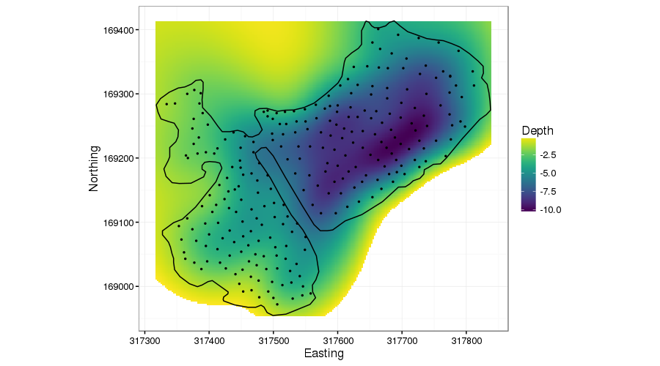
Correlation in space
Another interesting type of spline can be used for spatial areas with clear borders, e.g. a lake.
Taken from Gavin Simpsons blogg: http://www.fromthebottomoftheheap.net/2016/03/27/soap-film-smoothers/

Slide 41
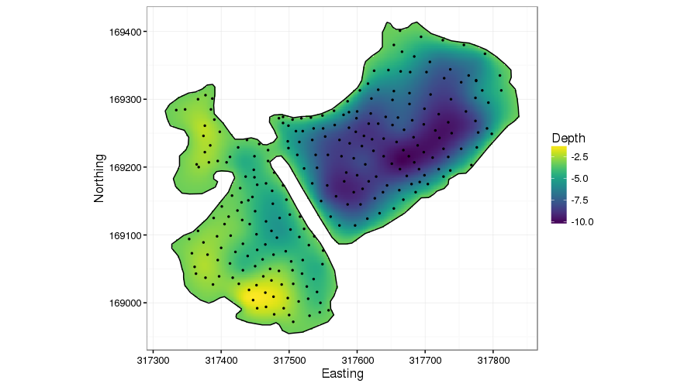
Correlation in space
Soap film smooth can adjust to the shape of the object that is modelled.
Taken from Gavin Simpsons blogg: http://www.fromthebottomoftheheap.net/2016/03/27/soap-film-smoothers/

Slide 42
Other types of dependencies in data
Hierarchical sampling leads to data on different levels, e.g.
several forests are selected,
within each forest a few plots are selected, and
within each plot 5 trees are selected
Observations of the individual trees can not be considered independent since their values can depend on with forest and which plot they stand on.
The dependency structure can be accounted for by nested/hierarchical factors.

Slide 43
Other types of dependencies in data
gamm(response~ s(expl.var), random=list(Forest= ~1, Plot=~1), data=urval)
You might recognize other coding of hierarchical factors:
+ (1|Forest/Plot)
random = ~ 1|Forest/Plot
In gamm only the named-list structure works.

Slide 44
An example of splines in SAS
Splines can be used in all types of GLM models in the GLIMMIX procedure:
proc glimmix data=in2 outdesign=x plots=all;
class cow;
effect myspline = spline(lactation_week);
model log_methane= myspline / s noint dist=normal;
random _residual_ /subject=cow type=un;
output out=gmxout pred(noblup)=p lcl(noblup)=lower ucl(noblup)=upper;
run;

Slide 45
An example of splines in SAS
proc sort data=gmxout;
by lactation_week;
run;
proc sgplot data=gmxout ;
series y=p x=lactation_week ;
keylegend / position=bottom border across=5;
band x=lactation_week lower=lower upper=upper ;
series y=p x=lactation_week ;
run;

Slide 46
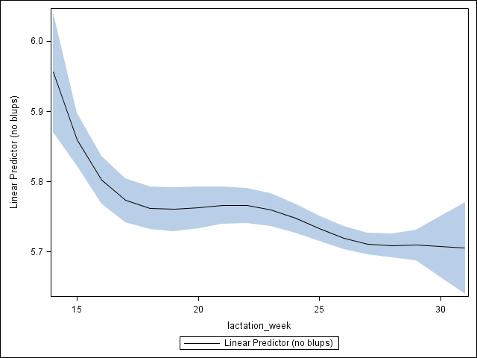
An example of splines in SAS

Slide 47
An example of splines in SAS
In GLIMMIX we can model data with normally distributed residual, as well as binomial and Poisson data.
We can also model temporal or spatial autocorrelations or other random factors.
Two-dimensional splines can not be fitted, but interactions to categorical variables are possible.

Slide 48
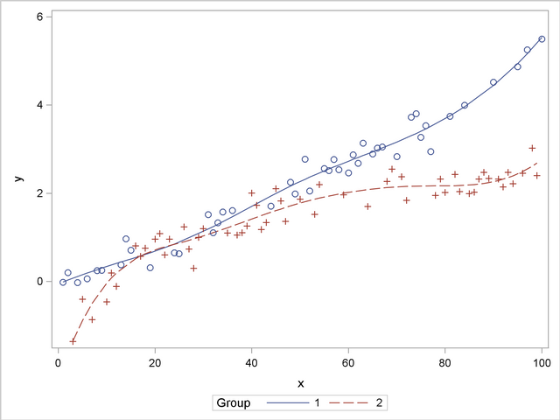
An example of splines in SAS

